Slide 1
Luontohoivaa perheille Pirkanmaalla - tukiprosesseja haasteellisiin elämäntilanteisiin eläin-, maatila-, luonto- ja puutarha-avusteisesti (gcfinland.fi)
Nature Care, Green Care for Families in Pirkanmaa

Slide 2
Project pilots the Nature care support process for families with economic and psychosocial stress factors in cooperation with the Green Care Pirkanmaa regional division and municipalities
Nature care for families in Pirkanmaa - support processes for challenging life situations with the help of animals, farms, nature and gardens - project pilots the Nature care support process for families with economic and psychosocial stress factors in cooperation with the Green Care Pirkanmaa regional division and municipalities. The project is aimed at families from Pirkanmaa whose life situation is burdened by e.g. mental health problems, the problems of adolescent schooling or the challenges of the neuro spectrum

Slide 3
Nature Care, Green Care for Families in Pirkanmaa
The chairman of the division: Sirpa Mäkinen, sirpa@soliseva.fi
Nature care for families in Pirkanmaa - support processes for challenging life situations with animal, farm, nature and garden assistance (gcfinland.fi)

Slide 4
About the Nature Care for Families in Pirkanmaa project
In 2022, the regional division has implemented the Nature care for families in Pirkanmaa project with the support of the Alli Paasikivi foundation.

Slide 5
Nature Care for Families in Pirkanmaa - support processes for challenging life situations with the help of animals, farms, nature and gardens - project
Project pilots the Nature care support process for families with economic and psychosocial stress factors in cooperation with the Green Care Pirkanmaa regional division and municipalities. The project is aimed at families from Pirkanmaa whose life situation is burdened by e.g. mental health problems, the problems of adolescent schooling or the challenges of the neuro spectrum.

Slide 6
About the Nature Care for Families in Pirkanmaa project
Green Care Pirkanmaa is responsible for the contents and goal-oriented implementation of the Nature Care for Families in Pirkanmaa project support processes together with experts from the region (organizations, small entrepreneurs). The goal of the project is to strengthen the family's internal interaction and everyday survival methods with the help of the Green Care operating model. Effects are systematically evaluated together with family and partners during the project.
Project time: 1.1.-31.12.2022

Slide 7
“GREEN CARE - IN ACTION STRENGTH THE FAMILY'S TURN FOR IMPACT”
Raportti Luontohoivaa perheille Pirkanmaalla hankkeen tuotoksista 2022 (gcfinland.fi)
GREEN CARE - IN ACTION STRENGTH THE FAMILY'S TURN FOR IMPACT
About evaluation to effectiveness:
Green Care - through action significant support of families to well-being

Slide 8
About the Nature Care for Families in Pirkanmaa project
https://www.gcfinland.fi/tiedostopankki/1021/Flyer-Luontohoivaa-perheille-Pirkanmaalla-hankkeen-tuotoksista-2022.pdf
NATURAL CARE FOR FAMILIES IN PIRKANMAA
GREEN CARE - IN ACTION STRENGTH TO THE FAMILY
FOR INTERACTION

Slide 9
About the Nature Care for Families in Pirkanmaa project
The evaluation process of Green Care activities implemented in the project has opened up the positive effects of the activity in an important way in supporting the well-being of families.
Included in the pilot a systematic evaluation process has made the operation possible family-specific effects and wider families making the impact that supports well-being visible.
The well-being effects obtained from pilot activities can be put to good use with a reason to call them significant on a social level.

Slide 10
About the Nature Care for Families in Pirkanmaa project
According to the results of the evaluation, Green Care can be used support internal family interaction, strengthen the family solidity and builds the agency of each family member and participation as a member of one's own family.
Family specific in addition to the increase in well-being, the valuable result of the project is that that Green Care activities support families on a more general level increase in resilience.
Green Care can therefore help both preventively and remedially, families to recover adversities and to build a working interaction as well family dynamics where every family member is important.

Slide 11
About the Nature Care for Families in Pirkanmaa project
The Nature care for families in Pirkanmaa project was made possible by the Alli Paasikiven Foundation. The project's operating period was 2022. The operation was targeted at families selected through the municipalities of Pirkanmaa.

Slide 12
About the Nature Care for Families in Pirkanmaa project
The project made it possible to experiment with a nature-based support process for ten families. The aim of the Nature Care for Families in Pirkanmaa project support processes was to strengthen and support the interactions within families with the help of the Green Care operating model and to gather information about the effectiveness of the models. The results of the project were positive.

Slide 13




About the Nature Care for Families in Pirkanmaa project
z

Slide 14
From evaluation to effectiveness: significant support for the well-being of families through Green Care activities.
The research material evaluating the family's interaction and solidity consisted of the answers to the questionnaires of the families who participated in the pilot (a total of 58 forms) and the self-assessment and diaries of the pilot implementers (a total of 10).
More information about the project: www.gcfinland.fi/ luontohoivaa-perheillePirkanmaalla/

Slide 15
The project is nature-oriented as supervisors
The project is nature-oriented as supervisors of support processes functioning social and health professionals.
Support process supervisors had also know-how about the target Green Care – methods utilization of children, with young people and families.
The family could choose from the themes of the Nature Care Support process: animal assistance, farm assistance, garden assistance and nature-oriented methods.

Slide 16
Evaluating the project
The family's situation, goals, support needs and the changes that occurred in them were evaluated at the beginning and end of the activity with a structured questionnaire. The children also had their own pictorial questionnaire. In addition, the family gave anonymous feedback on the functionality of the support process. The families' responses were analyzed without identifying information.

Slide 17
Evaluation process is opened the positive aspects of the operation in an important way effects in supporting the well-being of families
Nature care for families in Pirkanmaa - in the project the implemented Green Care evaluation process is opened the positive aspects of the operation in an important way effects in supporting the well-being of families.
A systematic included in the pilot activity the evaluation process has made the operation possible family-specific effects and wider families to make the impact that supports well-being visible doing.
Obtained from the pilot operation well-being effects can be called with good reason significant on a societal level.

Slide 18
The results of the evaluation
According to the results of the evaluation, Green Care activities can support the interaction within the family, strengthen the family's solidity and build the agency and involvement of each family member as a member of their own family.
In addition to the increase in family-specific well-being, a valuable result of the project is that Green Care activities support the growth of families' resilience on a more general level.
Green Care can therefore be used both preventively and remedially to help families to recover from adversity and to build functional interaction and family dynamics where every family member is important.

Slide 19
The results of the effects of the operation
The promising results of the effects of the operation did not come as a surprise to those implementing the pilot. The most important importance of the evaluation process is probably in showing the effectiveness of Green Care activities supporting the well-being of families and making them visible to a wider awareness.

Slide 20

Raportti Luontohoivaa perheille Pirkanmaalla hankkeen tuotoksista 2022 (gcfinland.fi)
According to the results of the evaluation, Green Care activities can support the interaction within the family, strengthen the family's solidity and build the agency and involvement of each family member as a member of their own family.
In addition to the increase in family-specific well-being, a valuable result of the project is that Green Care activities support the growth of families' resilience on a more general level.
Green Care can therefore be used both preventively and remedially to help families to recover from adversity and to build functional interaction and family dynamics in which every family member is important.

Slide 21
The evaluation process
The most important importance of the evaluation process is probably in showing the effectiveness of Green Care activities supporting the well-being of families and making them visible to a wider awareness.

Slide 22
Questionnaire
Every member of the family complied the first of the questionnaire during the appointment and again the same questionnaire the third (i.e. the last) during the appointment.
Queries were like this with each other comparable, allowing the process the change that occurred during was made visible.

Slide 23
For adults, children, and the youngest children, their own comparable questionnaires were built
For adults, children, and the youngest children, their own comparable questionnaires were built. This was to ensure the participation and hearing of every family member. The questions in the questionnaire measured different aspects of family interaction and family stability

Slide 24
At the end of the analysis
At the end of the analysis, what emerged from the entire material changes in family interaction and family was themed in solidity.
The themes describe some of the areas where the Green Care activity was successful positive effects on family well-being.
Respective the theme that emerged from the material has been further considered those methods of Green Care operations that are supported changes according to the theme of the family in the interaction and the solidity of the family.

Slide 25
Evaluation process and areas of family interaction where positive changes occurred:
Through the evaluation process measuring the effects and effectiveness of the Nature-caring families in Pirkanmaalla project, it emerged that the pilots were able to support positive changes in the following areas of family interaction and stability. The sub-areas therefore form the analysis themes that were opened above. Areas of family interaction where positive changes occurred:

Slide 26
1. The participation and activity of each family member as part of the family became stronger
Every member of the family was needed for the success of the activity
There were changes in the roles within the family -> he, who usually receives guidance and boundaries, now got to shine
Through the changes in roles everyone got experiences of success
The activity required a joint definition of the goal, and thus a joint discussion of the wishes and expectations of each family member
Influence motto, Effectiveness Motto: Our family is important!

Slide 27
2. Family cohesion, or emotional attachment between family members became stronger
Working together and functioning as a family significantly supported the feeling of family togetherness
Having fun together and rejoicing in your own success as well as the other's success supported the experience as a successful family sometimes strengthened
Influence motto, Effectiveness Motto: Together we are a team!

Slide 28
3. Family dynamics becoming visible and reciprocity between family members strengthened
Doing good to others and helping others brought a good mood and positive emotional experiences
The reciprocity of family members' relationships increased: everyone's being heard increased, especially the child's becoming visible in the eyes of the parent strengthened
Influence motto, Effectiveness Motto: I belong to our family and that's great!

Slide 29
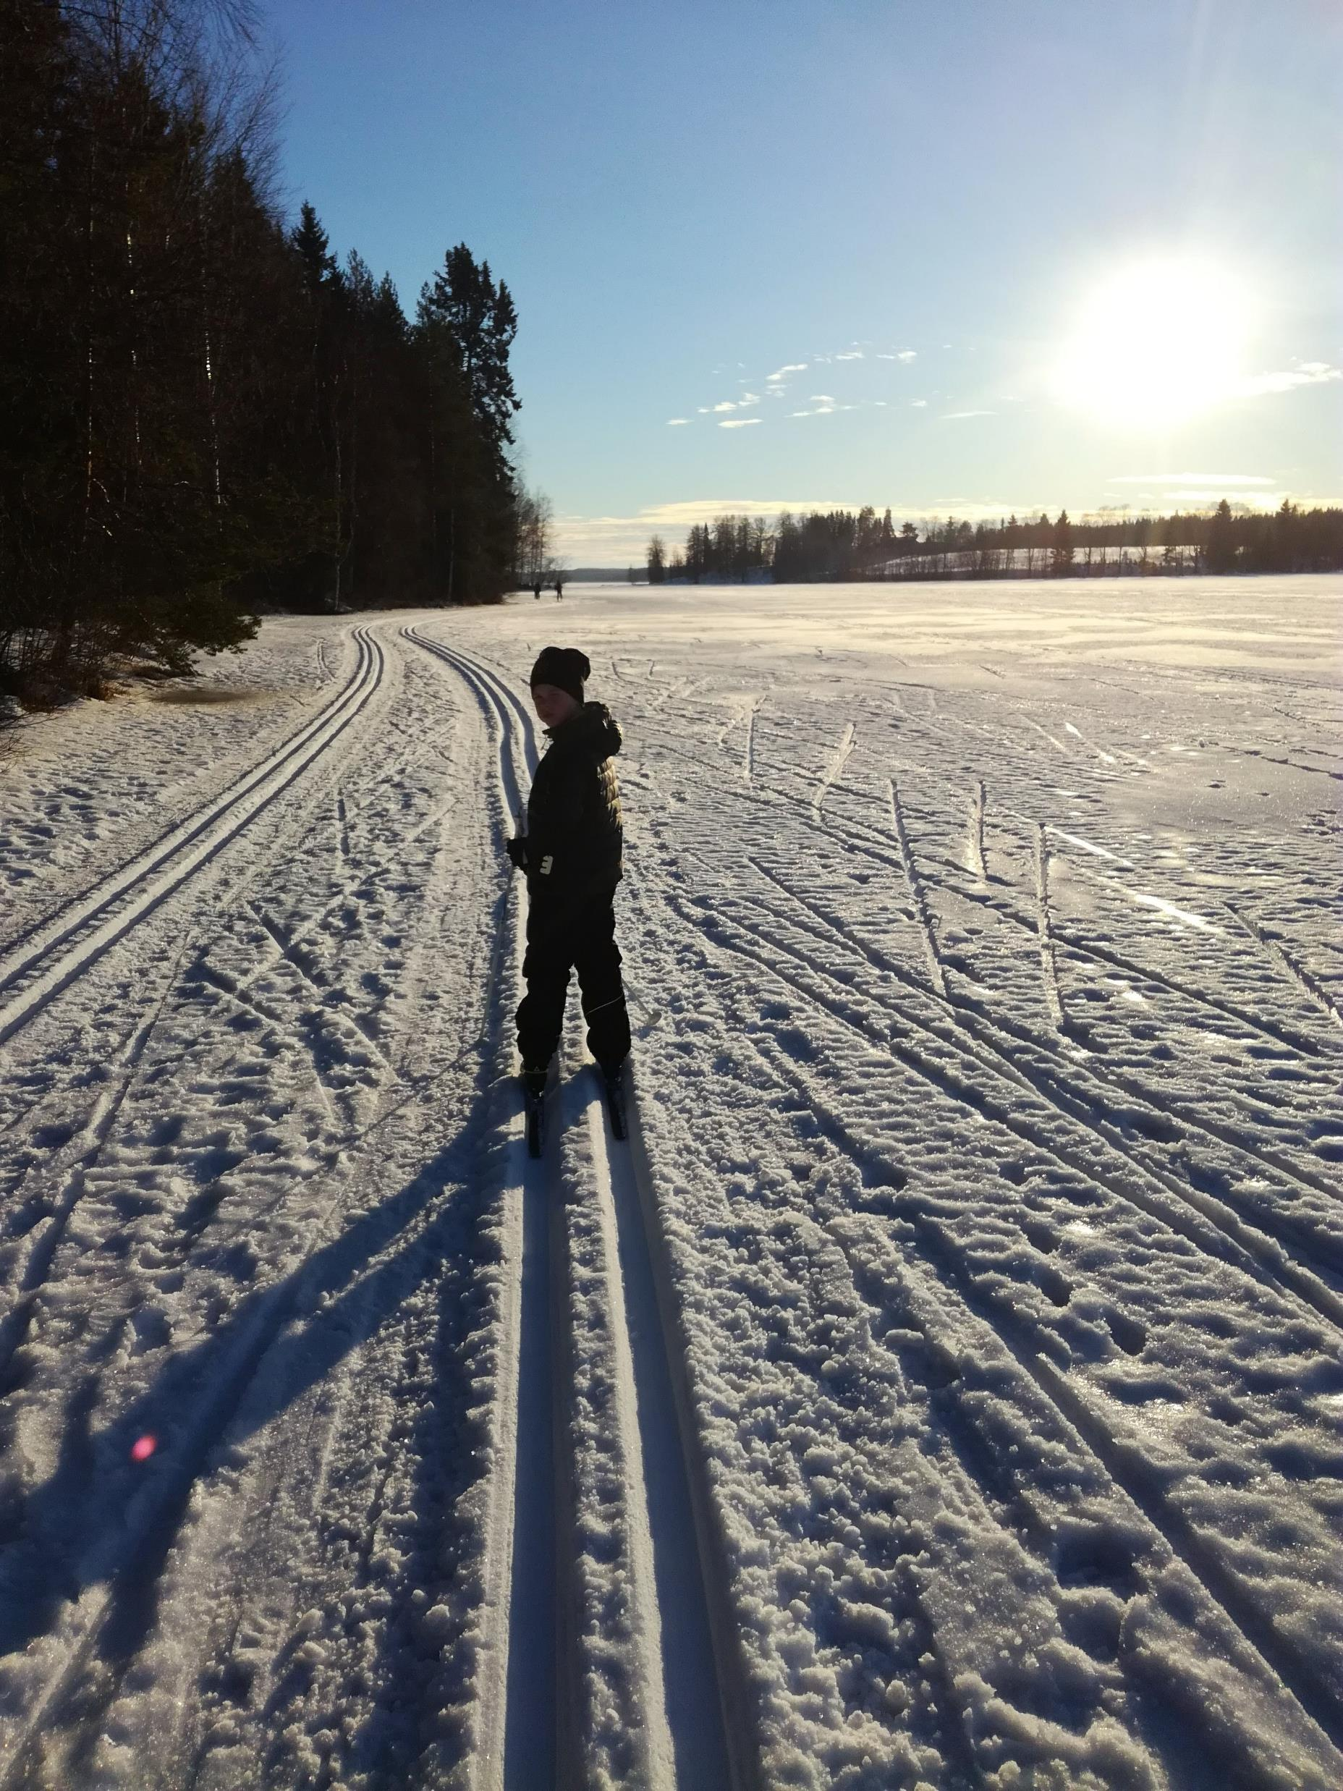
Factors implemented in Green Care operations that contributed to positive changes:
z

Slide 30
1. Through the Green Care activity, the family's strengths became visible and in the center
Finding positive things and strengths in our family as a whole and in myself as part of my own family
Influence motto, Effectiveness Motto: We will succeed!

Slide 31
2. Through the Green Care activity, the family's positive emotional experiences increased
The family's belief that they will manage together in the future was significantly strengthened in almost every family
Influence motto, Effectiveness Motto: We will survive!

Slide 32
3. Through the Green Care activity, the family's self-narrative became more positive and gained more hope
Weaknesses and challenges were gained from new perspectives, which strengthened the agency of the family and its members
Influence motto, Effectiveness Motto: We stay together and overcome difficulties!

Slide 33
The evaluation process
The evaluation process gave birth to an important realization that through Green Care activities, the resilience of the family can be strengthened and increased, i.e. the ability to survive and recover together as a family from the challenges facing the family. The effects of the Green Care activity as an activity promoting family interaction can have a significant impact on family resilience.

Slide 34
Family resilience describes the family's ability to face challenges as a community, in which case it is more than the sum of the individual resilience of family members. In terms of family resilience, the following things are essential:
common ways of thinking with which the family understands the difficulty they are facing, its significance and sees opportunities to overcome it
families have optimism about themselves and faith in the future
the family's resilience is strengthened especially through the joint activities of the family

Slide 35
Results
Although the resilience of the family is more than the resilience of the family's children, when evaluating the effects of Green Care activities, the possibilities of Green Care activities to support children's resilience should also be taken into account.
A child's resilience is based on the adult's supportive interaction with the child and the adult's positive interaction with the child.
These two factors emerged in each of the pilots involved in the project, both through the pilot implementer and the pilot participants.

Slide 36
You find more information from this raport:
Raportti Luontohoivaa perheille Pirkanmaalla hankkeen tuotoksista 2022 (gcfinland.fi)

Slide 37
Green Care in Finland
In English (gcfinland.fi)
“Green Care Finland ry, established in 2010, works to coordinate, develop and promote the use of nature and animal assisted methods in combination with wellbeing and health services in Finland.”

Slide 38
Green Care in Finland
“In Finland, two distinct domains are distinguished, Green Care and Green Empowerment. The clients of Green Care (in Finnish, Luontohoiva) typically include vulnerable groups such as the elderly, immigrants, mentally and/or physically disabled. These services are given within the prevailing legislation of health care and social services. “

Slide 39
Green Care in Finland
“The services of Green Empowerment (in Finnish, Luontovoima) include activities supporting the overall mental and physical wellbeing of all people. The activities can be considered as preventive measures: they are typically conducted by organizations concerned with wellbeing or nature tourism.”

